Slide 1
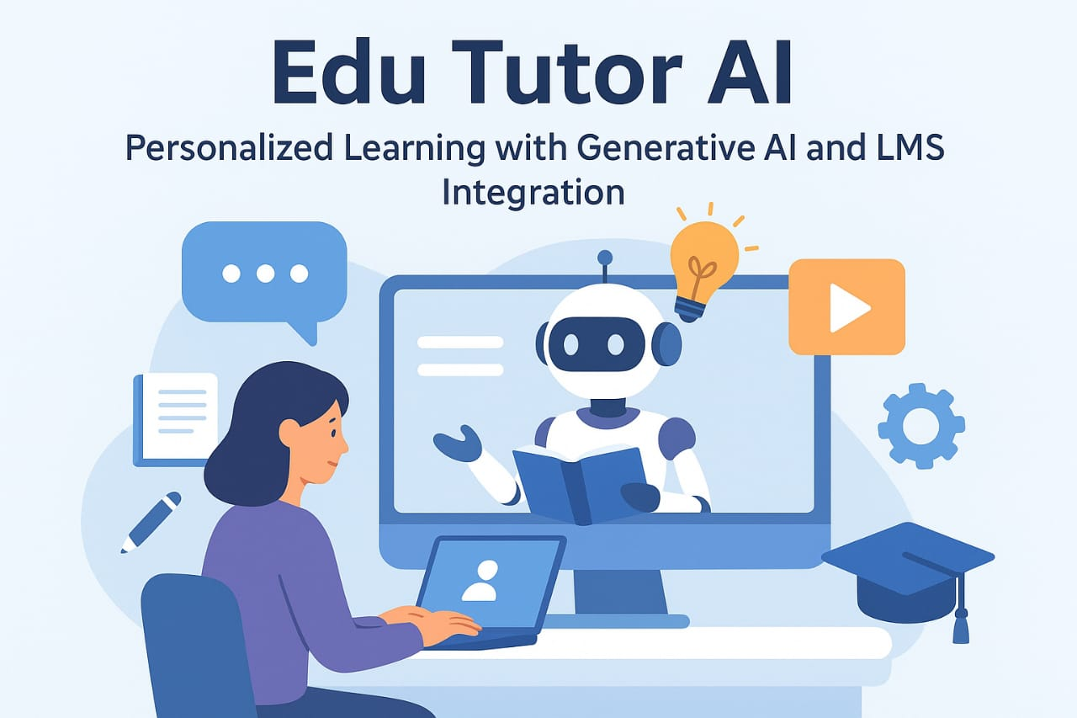
EduTutor AI : Personalized Learning With Generative AI And LMS Integration
Team Members
Manjuparkavi K
Vinothini S
Priyadharshini R
Introduction
Overview of modern education challenges:
One-size-fits-all learning models.
Lack of engagement.
Teacher workload.
The rise of AI in education.

Slide 2
What is EduTutor AI?
A smart educational platform that combines generative AI with Learning Management Systems (LMS) to deliver personalized, adaptive learning experiences
Key Features of EduTutor AI
Personalized Learning Paths
AI dynamically adapts content to each learner's:
Skill level
Learning style
Pace
Interests
Real-time assessment of strengths and weaknesses.
Generative AI-Powered Content Creation
Auto-generates:
Practice quizzes and tests
Summaries and flashcards
Adaptive explanations and examples
Supports multiple languages and reading levels.
Seamless LMS Integration
Integrates with platforms like Moodle, Canvas, Google Classroom, Blackboard, etc.
Syncs grades, assignments, and student progress.
Works inside the LMS without disrupting existing workflows.
Intelligent Tutor Chatbot
Always-on AI tutor available 24/7.
Provides hints, answers questions, and explains concepts.
Context-aware: understands course structure and past performance.
Data-Driven Insights for Educators

Slide 3
Dashboards for:
Student progress
Engagement analytics
Predictive alerts (e.g., who is likely to fall behind)
Suggests interventions and content adjustments.
How It Works
Step 1:
LMS Integration
Secure API-based connection to the existing LMS.
Auto-sync of users, content, and assignments.
Step 2:
AI Learner Profiling
Learner behavior and past data analyzed to create a learning profile.
Step 3:
Personalized Content Delivery
Lessons, assignments, and assessments are tailored dynamically.
Step 4:
Continuous Feedback Loop
Real-time data improves personalization and content quality.
Use Cases
K–12 Schools
Differentiated instruction in large classrooms.
Higher Education
Personalized support for complex topics.
Corporate Training
Upskilling employees with adaptive learning paths.
EdTech Companies
Embed Edutor AI into existing apps for smart tutoring.

Slide 4
Stakeholder | Benefits
Students | Improved outcomes, engagement, 24/7 support
Teachers | Reduced workload, insights, smart grading
Institutions | Scalable learning, better performance tracking
Parents | Transparency into learning journey
Technology Stack (Optional for Technical Audience)
Frontend: React / Flutter (for mobile apps)
Backend: Node.js / Python (FastAPI)
AI Models: GPT-4 (OpenAI), BERT, custom LLM fine-tunes
LMS Integration: LTI, SCORM, REST APIs
Data: PostgreSQL, Firebase, Learning Record Store (LRS)
Security: GDPR, FERPA-compliant, OAuth2
Competitive Advantage
Combines the best of AI + human pedagogy.
Modular architecture: easy plug-in for any LMS.
Learner-centric vs content-centric.
Constantly improving through reinforcement learning.
Future Roadmap
Voice-based tutoring
AI-generated video lessons
AR/VR content integration
Peer-to-peer AI collaboration bots
Call to Action
For schools: Start a free pilot program
For developers: Integrate EduTutor AI into your LMS
For investors: Join us in transforming global education

Slide 5
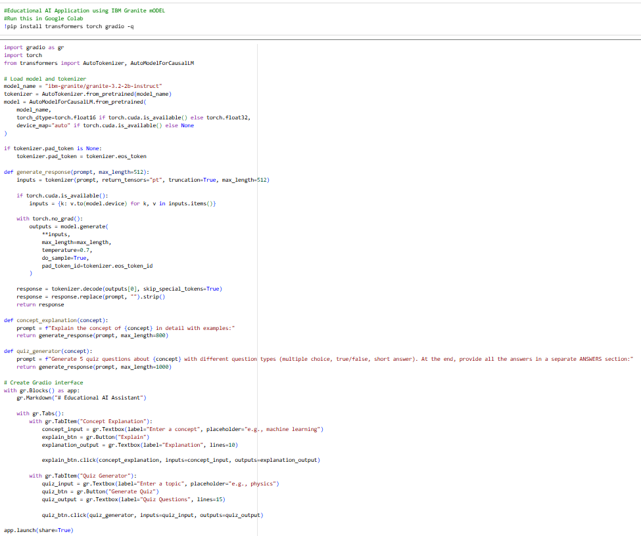
PROJECT SCREENSHOT

Slide 6
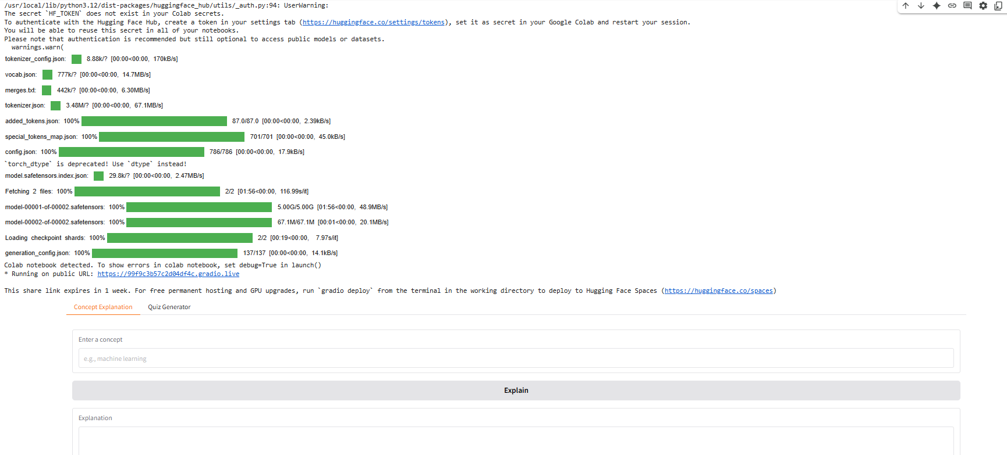
OUTPUT SCREENSHOTS
Project link: https://0e3b66cdce24e65c18.gradio.live
Demo video link:
https://ik.imagekit.io/kk472ir2h/VID-20250918-WA0002.mp4?updatedAt=1758169542168

Slide 7
THANK YOU

